Slide 1
Matrix Methods in the Study of Geometrical Optics
INTRODUCTION :
Optical systems are, in general, made up of a large number of refracting surfaces. In order to obtain the position of the final image due to an optical system, one has to calculate step by step the position of the image due to each surface and consider this image as an object for the next surface. Such a step by step analysis becomes lengthy and tedious. In order to solve such problems easily and more efficiently K. Hallback has introduced in 1964 matrix methods in the study of geometrical optics. The matrix method is less cumbersome and above that, it is more amenable to computer use.

Slide 2
REFRACTION AND TRANSLATION
A ray of light propagating through a cylindrically symmetric optical system undergoes two operations. Refraction and Translation. To full describe the ray propagation through an optical system, we make use of two operators. These two operators are known as refraction matrix and the translation matrix respectively.
There is a point to point correspondence between object space and the image space. Every point (x, y, z) in object space gets transformed into the point (x’, y’, z’) in the image space. The transformation is linear in case of paraxial ray approximation and hence matrix operation can be used for the purpose.

Slide 3
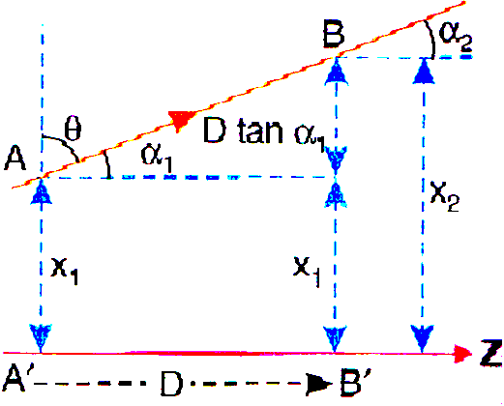
The point A is at a distance χ₁ from the axis. Also the ray is inclined at an angle α₁ at A with the z-axis, which is chosen as the axis of the optical system. If the ray makes an angle θ with the x-axis, then
λ₁ = μ cos θ
Where λ₁ is known as the optical direction cosine of the ray at A. The coordinates of the ray at A are specified by either (χ₁, α₁) or (λ₁ , χ₁). Similarly, the coordinates of the ray at point B are given by either (χ₂, α₂) or (λ₂, χ₂).

Slide 4
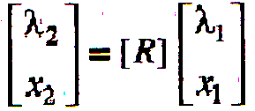
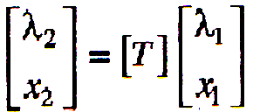
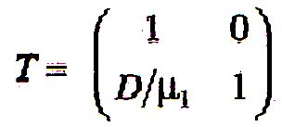
The matrix [R] is called the refraction matrix.
The matrix [T] is called the translation matrix.
The matrix is called translation matrix. It may be noted that

Slide 5
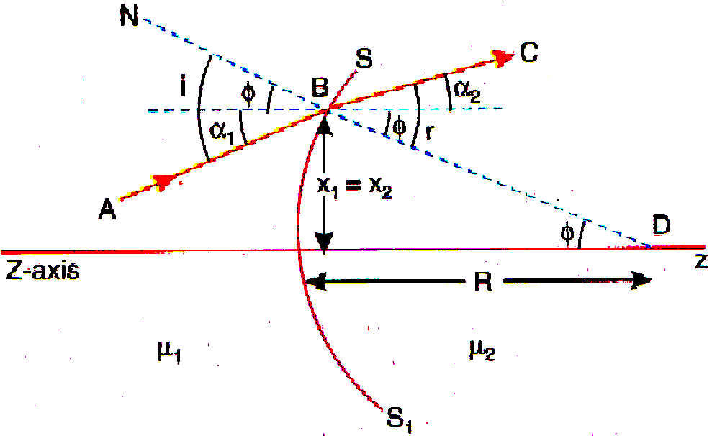
REFRACTION MATRIX
The refraction of a ray at a spherical surface.

Slide 6
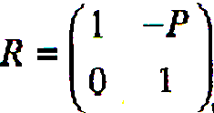
Which is known as the refraction matrix.
Again it may be noted that

Slide 7
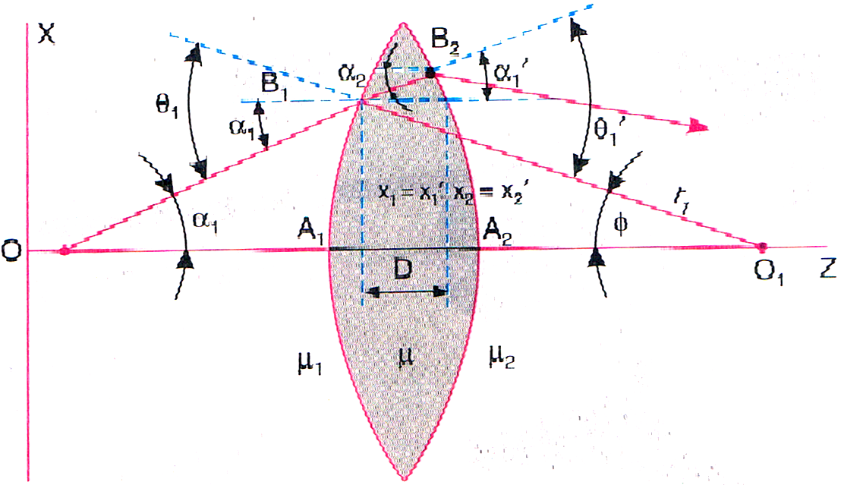
SYSTEM MATRIX
The passage of the ray through the first refracting surface is described by

Slide 8
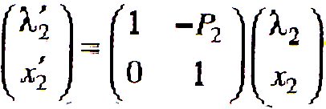
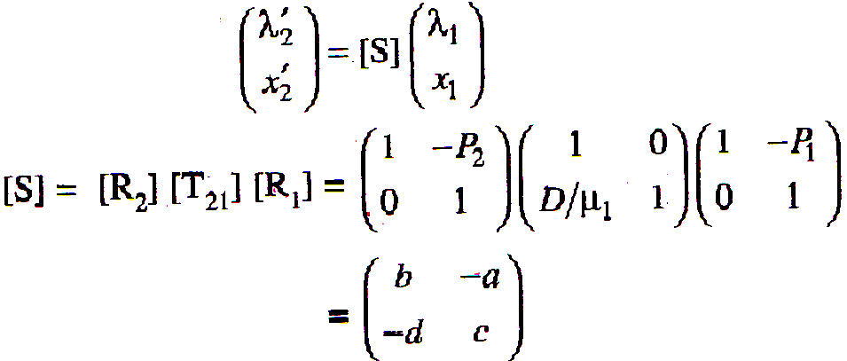
The refraction at the second surface may be written as

Slide 9
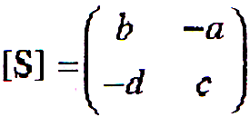
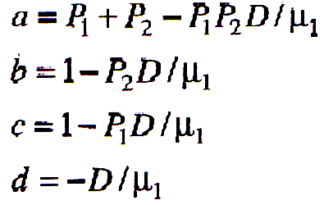

Slide 10
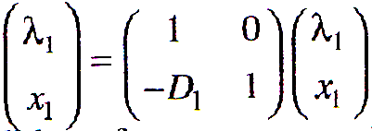
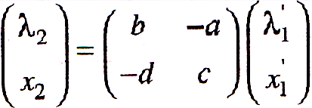
POSITION OF THE IMAGE PLANE
Let (λ₁, χ₁), (λ₁, ‘χ₁’), (λ₂, ‘χ₂’), (λ₂, ‘χ₂’) be the co-ordinates of point O’, A, B and I’ respectively.

Slide 11
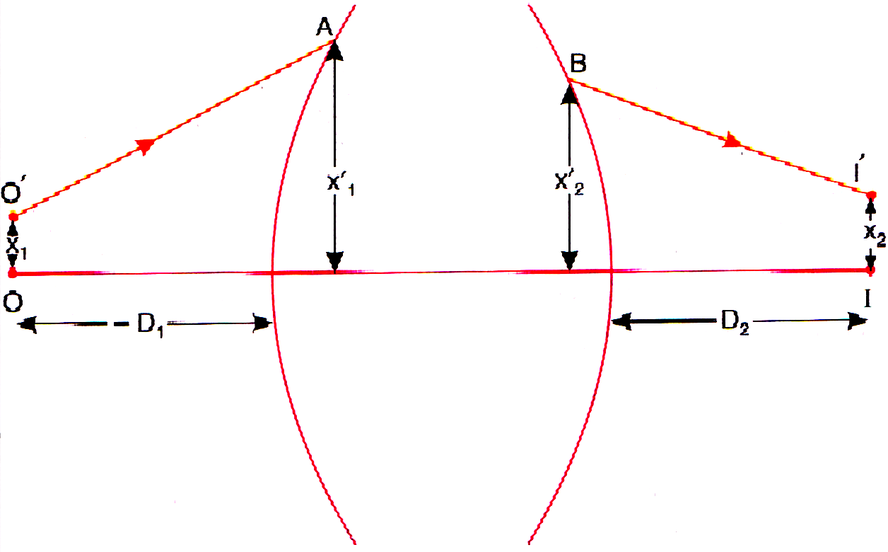
The object point 0 is at a distance (-D₁) from the first refracting surface. The paraxial image in assumed to be formed at a distance D₂ from the last refracting surface.

Slide 12
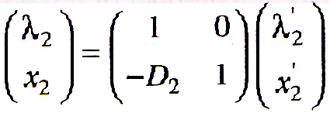
Multiplying the right hand side in proper order we get

Slide 13
When the object is point size and lying on the axis, the image is also a point lying on the axis.
So x₁ = 0 and x₂ = 0. Therefore, equ. reduces to
0 = (bD₂ + aD₁D₂ – cD₁ – d) λ₁
But λ₁ ≠ 0
∴
bD₂ + aD₁D₂ – D₁ – d = 0
If x₁ ≠ 0 and x₂ ≠ 0, the using in equ. we get
x₂ = (c – aD₂) x₁

Slide 14
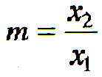
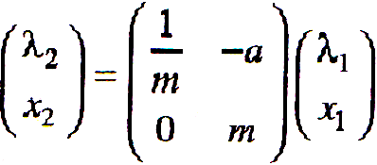
MAGNIFICATION

Slide 15
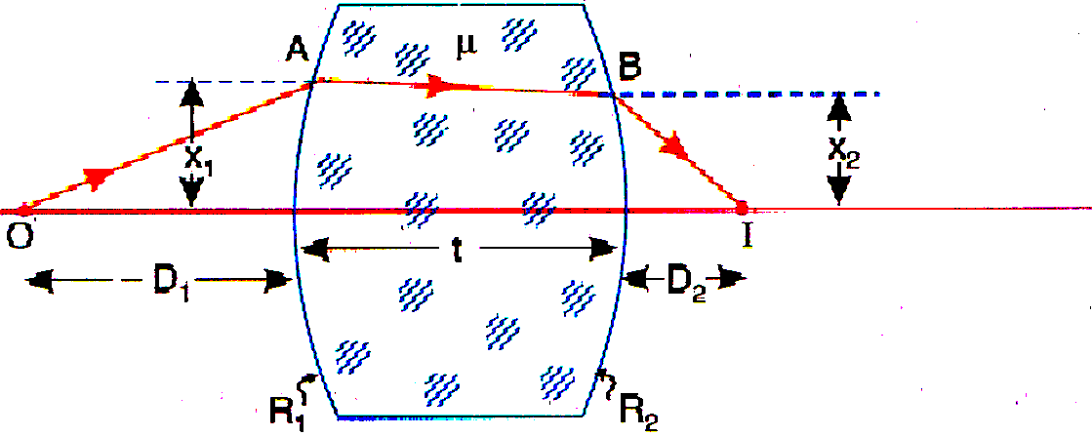
SYSTEM MATRIX FOR THICK LENS
A paraxial ray passing through a thick lens of thickness ‘t’

Slide 16
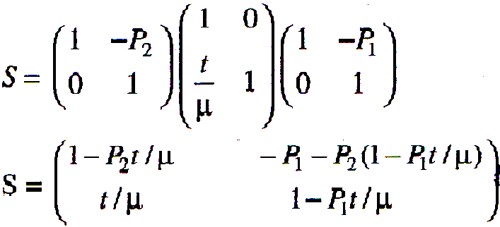
FOCAL LENGTH OF THICK LENS

Slide 17
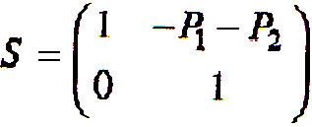
SYSTEM MATRIX FOR THIN LENS
In the case of thin lens, the thickness may be assumed to be negligibly small (t 0) and hence the system matrix takes the form
LENS MAKER’S FORMULA OR FOCAL LENGTH OF THIN LENS

Slide 18
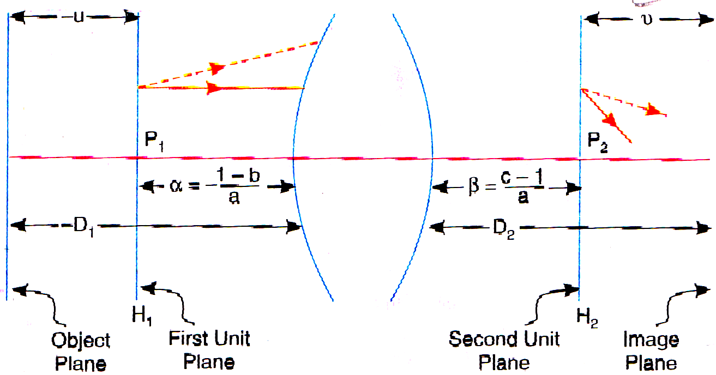
CARDINAL POINTS OF AN OPTICAL SYSTEM
The cardinal points of an optical system are,
(i) two principal or unit points,
(ii) two focal points, and
(iii) two nodal points.
P₁ H₁ and P₂ H₂ are the two unit planes. A ray emanating at any height from the first unit plane will cross the second unit plane at the same height.

Slide 19
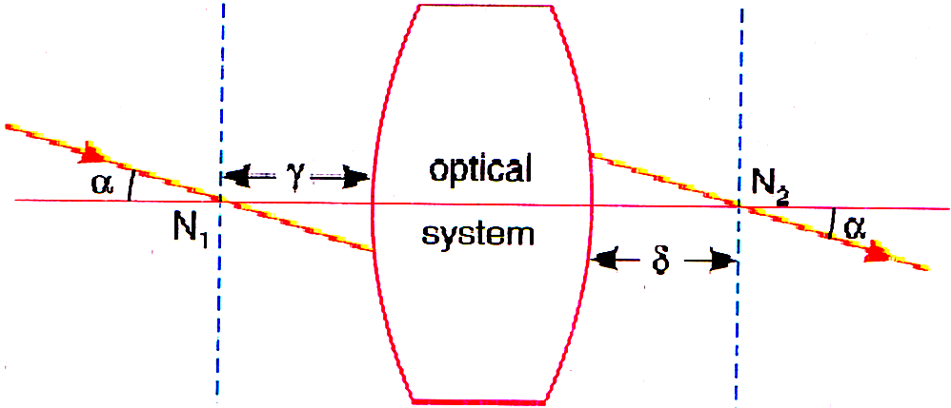
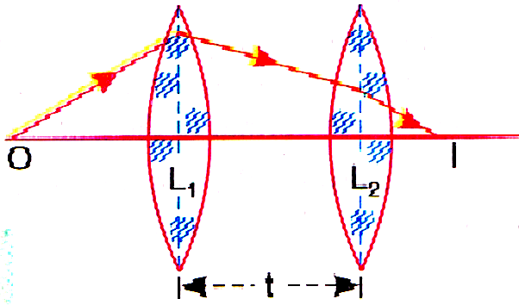
NODAL PLANES
SYSTEM MATRIX FOR TWO THIN LENSES

Slide 20
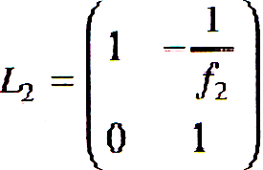
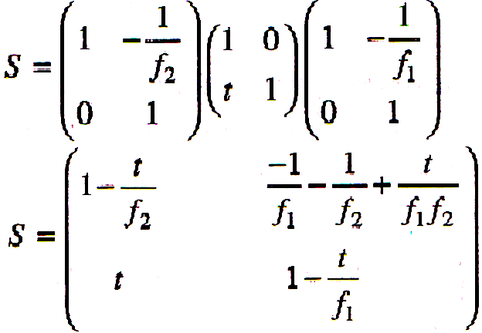
System matrix for lens
Similarly, the system matrix for lens
The total system matrix is
given by

Slide 21
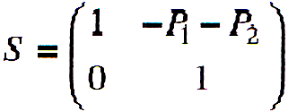
EFFECTIVE FOCAL LENGTH
We know that the element ‘a’ in the system matrix represents the inverse of focal length F of the system. Therefore,
Example 1 : Obtain the system matrix for a thin lens placed in air and made of refractive index 1.5 and radii of curvature 50 cm each.

Slide 22
Example 2 : The focal lengths of two thin convex lenses are 20 cm and 10 cm. They are at a distance of 1`0 cm on the axis of symmetry. If a point object of length 1 cm is placed at a distance of 20 cm from the first lens, find the position of the image and magnification.
Example 3 : A thick bi-convex lens having radii of curvature + 6 cm and – 6 cm is made up of a material of refractive index 1.6. If the thickness of the lens is 2 cm. Find (a) System matrix (b) focal length (c) unit planes.

Slide 23
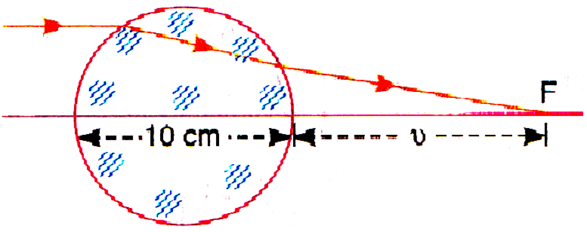
Example 4 : Two thin converging lenses of powers 5 and 4 diopters are placed co-axially 10 cm apart. Find the focal length of the combination.
Example 5 : Find the position of paraxial point of a lens in the form of a sphere of glass of radius 5 cm and refractive index is shown below.

Slide 24
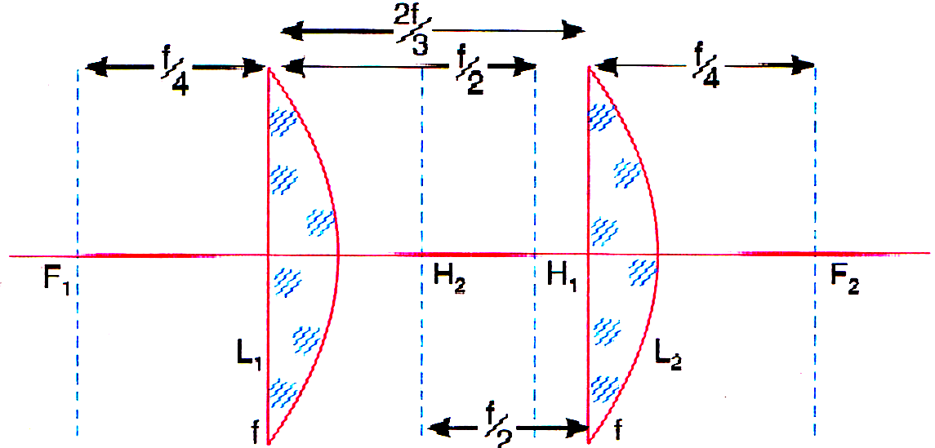
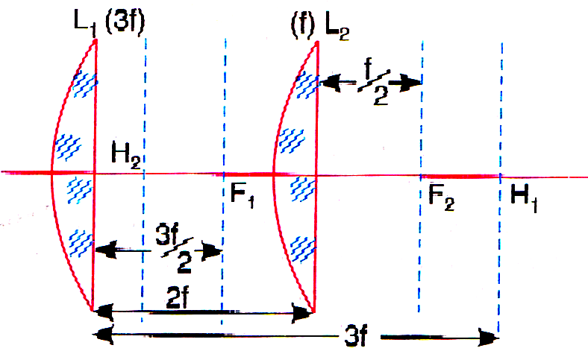
Example 6 : Find the focal length, and unit planes of Ramsden’s eye piece.
Example 7 : Find the focal length, unit planes of Huygens’s eye piece.

Slide 25
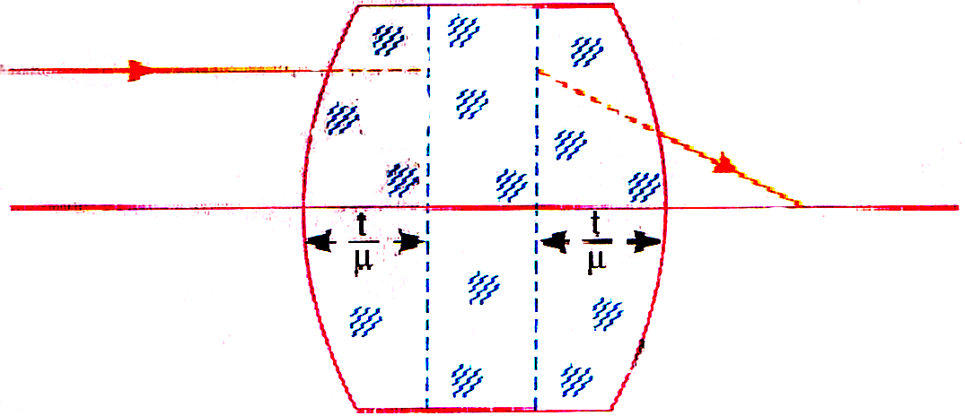
Consider a thick equi-convex lens (made of a material of refractive index 1.5) of the type shown in the magnitude of the radii of curvature of the two surface is 4 cm, the thickness of the lens is 1 cm and the lens is placed in air. Obtain the system matrix and determine the focal length and the positions of unit planes.

Slide 26
The End

